Slide 1
Summer Internship Project
Sosial
A small social media platform

Slide 2
Contents Abstract section 1. Overview of the application 2. Demonstration of the application Technical section 3. Language, framework & tools used 4. Generalized Code snippet of important function 4. Database design pattern 5. Applicationflowchart

Slide 3
Overview
Sosial is a web application which is a small social media platform
Users can register an account and setup their profile infos
Users can upload profile pictures, stories
Users can visit other user’s profile and check their stories

Slide 4
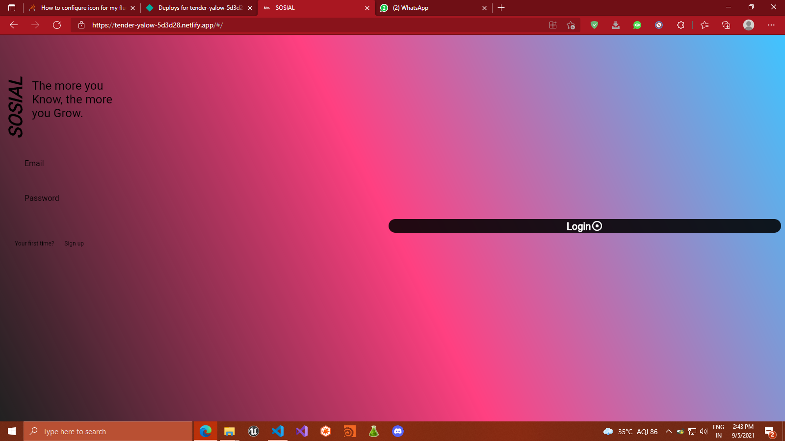
Demonstration

Slide 5
Technical Informations
Language : Dart
Frontend framework : Flutter
Backend : Google’s firebase
Frontend tools:
1. Providers - state management solution
Backend tools:
None

Slide 6
Code snippets of important functions

